Slide 1
Hidden Markov Model

Slide 2
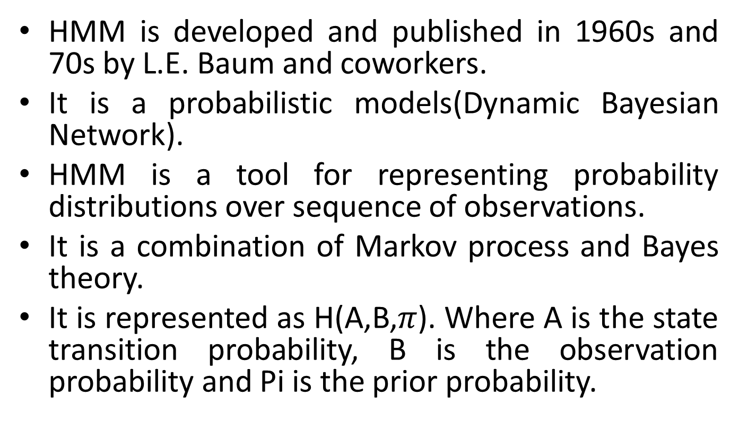
Introduction
HMM is developed and published in 1960s and 70s by L.E. Baum and coworkers.
It is a probabilistic models(Dynamic Bayesian Network).
HMM is a tool for representing probability distributions over sequence of observations.
It is a combination of Markov process and Bayes theory.
It is represented as H(A,B,$π$). Where A is the state transition probability, B is the observation probability and Pi is the prior probability.

Slide 3
Applications of HMM
Uses
Speech recognition
Recognizing spoken words and phrases
Gesture recognition
Recognizing hand gestures
Text processing
Parsing raw records into structured records
Bioinformatics
Protein sequence prediction
Financial
Stock market forecasts (price pattern prediction)
Comparison shopping services

Slide 4
Main Problems of HMMs
Evaluation problem. Given the HMM M=(A, B, π) and the observation sequence O=o₁ o₂ ... o_{K} , calculate the probability P(O|M) which shows the probability of observation sequences given to HMM .
Decoding problem. Given the HMM M=(A, B, π) and the observation sequence O=o₁ o₂ ... o_{K} , calculate the most likely sequence of hidden states s_{i} that produced the most probable state path to get the given observation sequences.
Learning problem. Given some training observation sequences O=o₁ o₂ ... o_{K} and general structure of HMM (numbers of hidden and visible states), determine HMM parameters M=(A, B, π) that best fit training data.
O=o₁...o_{K} denotes a sequence of observations o_{k}∈{v₁,…,v_{M}}.

Slide 5
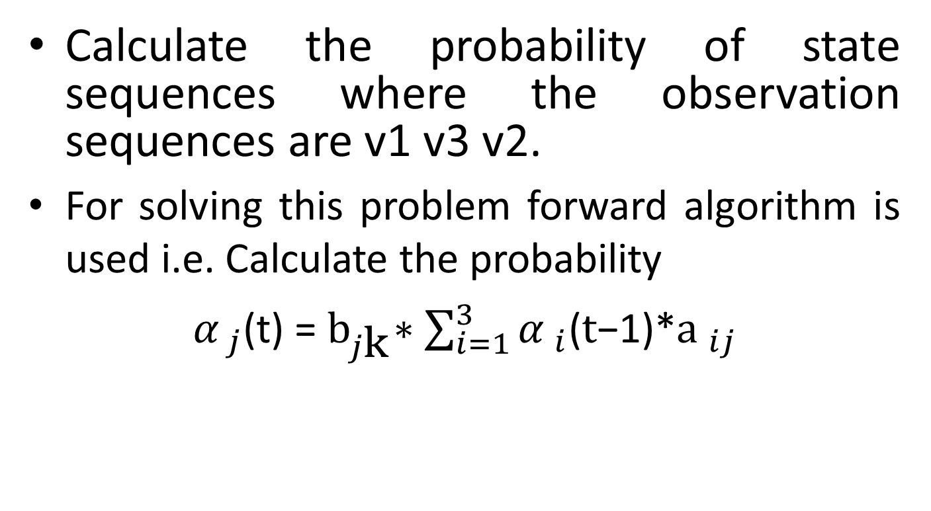
Problem 1
Calculate the probability of state sequences where the observation sequences are v1 v3 v2.
For solving this problem forward algorithm is used i.e. Calculate the probability
${ α }_{j}$(t) = ${\text{b}}_{j\text{k}}∗\sum_{i=1}^{3}{{α }_{i}\text{(}t\text{−1)}}$*${\text{a} }_{ij}$

Slide 6
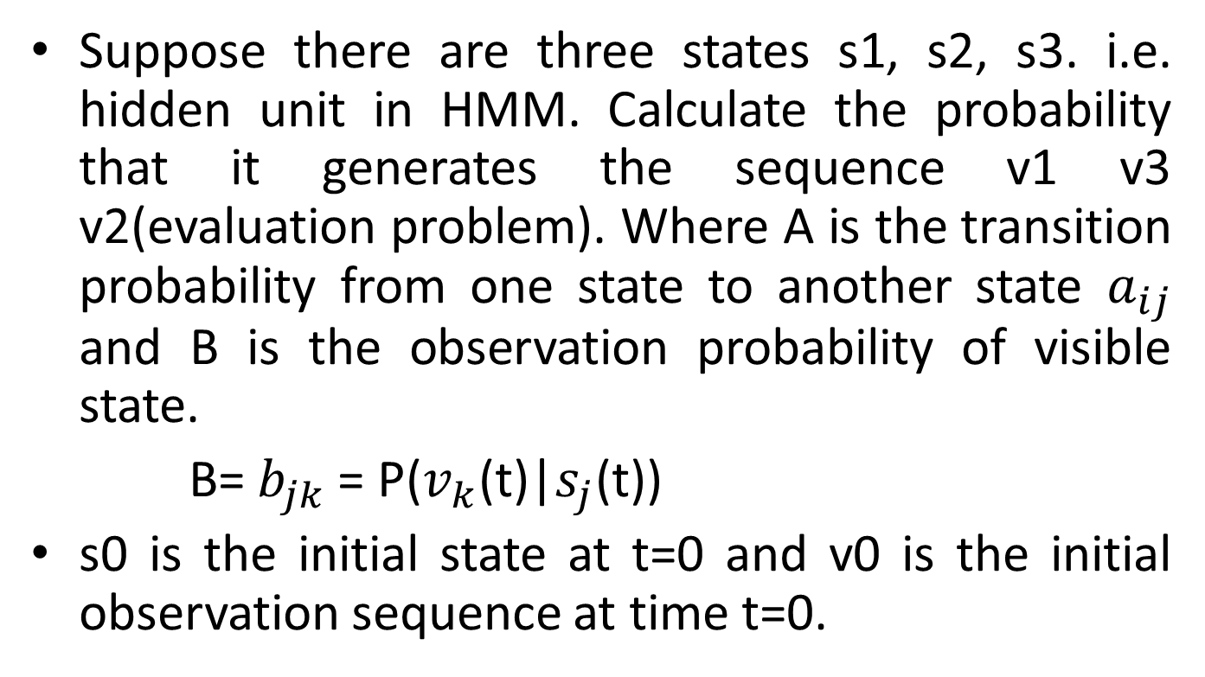
Suppose there are three states s1, s2, s3. i.e. hidden unit in HMM. Calculate the probability that it generates the sequence v1 v3 v2(evaluation problem). Where A is the transition probability from one state to another state $a_{ij}$ and B is the observation probability of visible state.
B= $b_{jk}$ = P($v_{k}$(t)|$s_{j}$(t))
s0 is the initial state at t=0 and v0 is the initial observation sequence at time t=0.

Slide 7
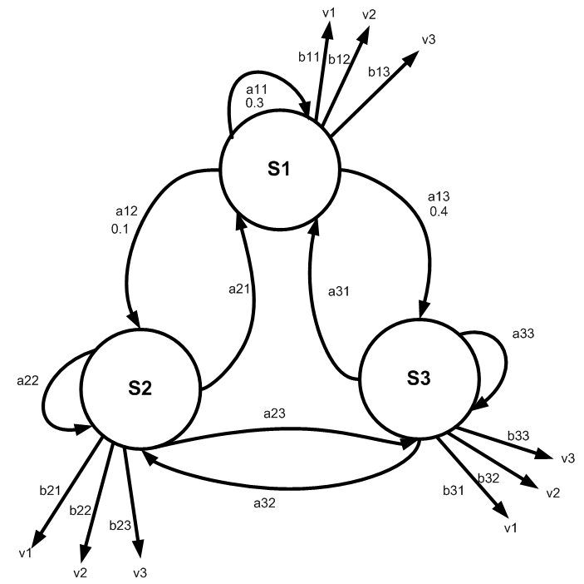

Slide 8

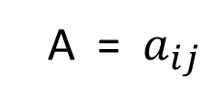
Transition probability matrix
 | s0 | s1 | s2 | s3
s0 | 1 | 0 | 0 | 0
s1 | 0.2 | 0.3 | 0.1 | 0.4
s2 | 0.2 | 0.5 | 0.2 | 0.1
s3 | 0.8 | 0.1 | 0.0 | 0.1
A = $a_{ij}$
Observation probability matrix
 | v0 | v1 | v3 | v2
s0 | 1 | 0 | 0 | 0
s1 | 0 | 0.3 | 0.4 | 0.3
s2 | 0 | 0.2 | 0.1 | 0.7
s3 | 0 | 0.5 | 0.4 | 0.1
B = $b_{jk}$
Initial probabilities: say P(s1)=0.3 , P(s2)=0.2, P(s3)=0.1.
Prior probability: [1 0 0]

Slide 9
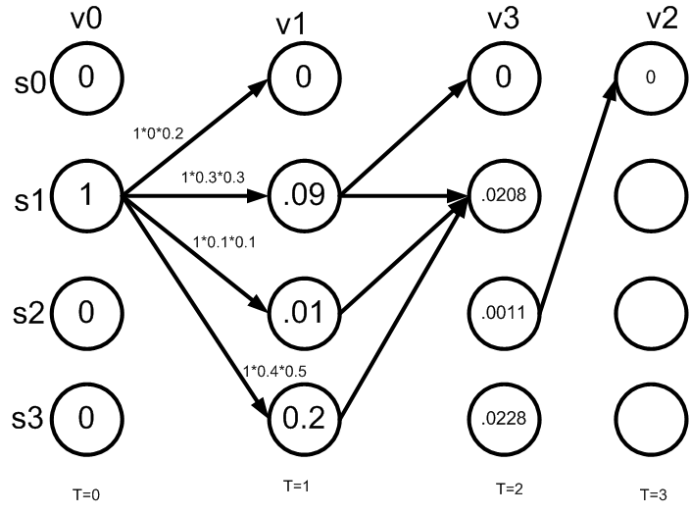

Slide 10
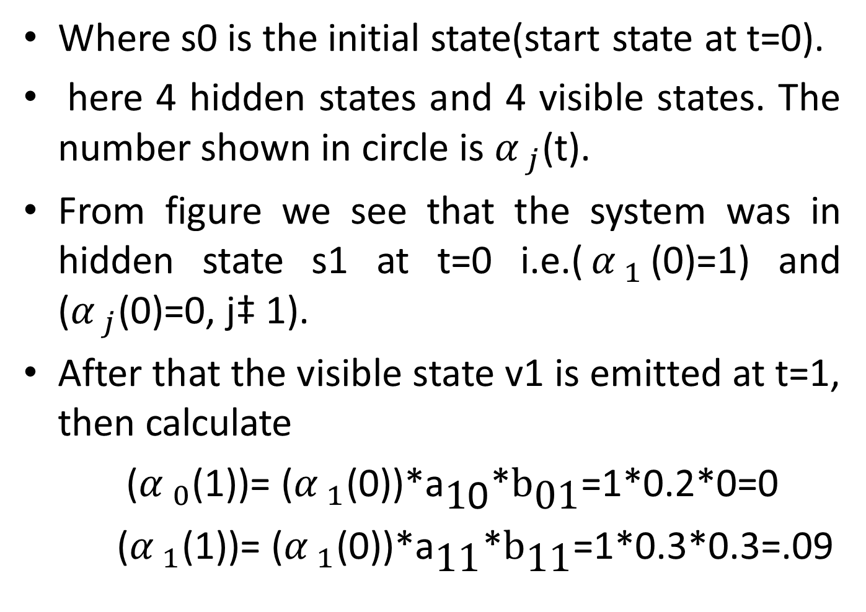
Where s0 is the initial state(start state at t=0).
here 4 hidden states and 4 visible states. The number shown in circle is ${α }_{j}$(t).
From figure we see that the system was in hidden state s1 at t=0 i.e.(${α }_{1}$(0)=1) and (${α }_{j}$(0)=0, j‡ 1).
After that the visible state v1 is emitted at t=1, then calculate
(${α }_{0}$(1))= (${α }_{1}$(0))*${\text{a}}_{\text{1}\text{0}}$*${\text{b}}_{\text{01}}$=1*0.2*0=0
(${α }_{1}$(1))= (${α }_{1}$(0))*${\text{a}}_{\text{11}}$*${\text{b}}_{\text{11}}$=1*0.3*0.3=.09

Slide 11
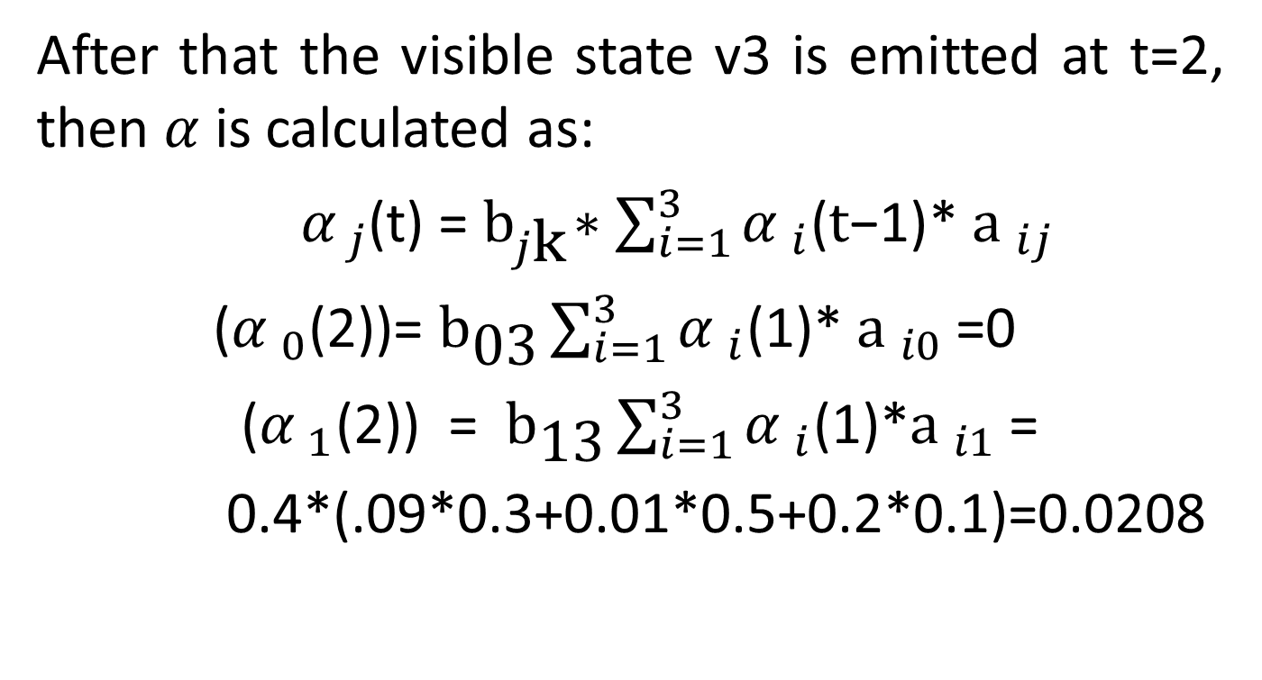
After that the visible state v3 is emitted at t=2, then $α$is calculated as:
${ α }_{j}$(t) = ${\text{b}}_{j\text{k}}∗\sum_{i=1}^{3}{{α }_{i}\text{(}t\text{−1)}}$* ${\text{a} }_{ij}$
(${α }_{0}$(2))= ${\text{b}}_{\text{03}}\sum_{i=1}^{3}{{α }_{i}\text{(1)}}$* ${\text{a} }_{i0}$=0
(${α }_{1}$(2)) = ${\text{b}}_{\text{13}}\sum_{i=1}^{3}{{α }_{i}\text{(1)}}$*${\text{a} }_{i1}$=
0.4*(.09*0.3+0.01*0.5+0.2*0.1)=0.0208

Slide 12
Forward Calculation
 | t=0 v0 | t=1 v1 | t=2 v3 | t=3 v2
α₀(t) | 0 | 0 | 0 | 0
α₁(t) | 1 | 0.09 | 0.0208 | 0.00079
α₂(t) | 0 | 0.01 | 0.0011 | 0.001596
α₃(t) | 0 | 0.2 | 0.0228 | 0.000237

Slide 13
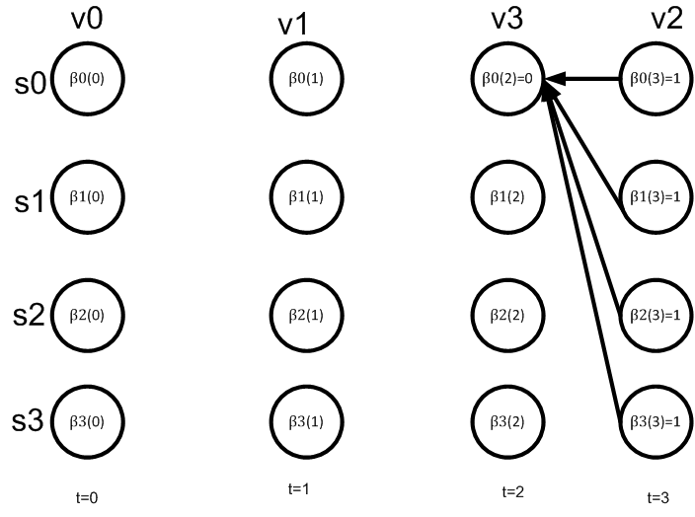
Backward Algorithm

Slide 14
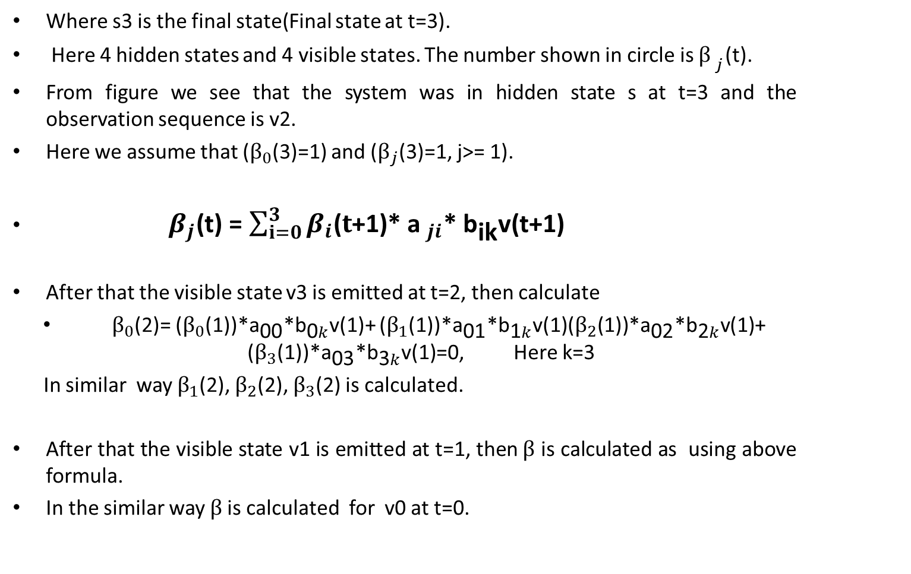
Where s3 is the final state(Final state at t=3).
Here 4 hidden states and 4 visible states. The number shown in circle is ${β }_{j}$(t).
From figure we see that the system was in hidden state s at t=3 and the observation sequence is v2.
Here we assume that ($β_{0}$(3)=1) and ($β_{j}$(3)=1, j>= 1).
${ β}_{j}$(t) = $\sum_{i=0}^{3}{β_{i}\text{(}t\text{+1)}}$* ${\text{a} }_{ji}$* ${\text{b}}_{\text{i}\text{k}}$v(t+1)
After that the visible state v3 is emitted at t=2, then calculate
$β_{0}$(2)= ($β_{0}$(1))*${\text{a}}_{\text{00}}$*${\text{b}}_{\text{0}k}$v(1)+ ($β_{1}$(1))*${\text{a}}_{\text{0}\text{1}}$*${\text{b}}_{\text{1}k}$v(1)($β_{2}$(1))*${\text{a}}_{\text{02}}$*${\text{b}}_{\text{2}k}$v(1)+ ($β_{3}$(1))*${\text{a}}_{\text{03}}$*${\text{b}}_{\text{3}k}$v(1)=0, Here k=3
In similar way $β_{1}$(2), $β_{2}$(2), $β_{3}$(2) is calculated.
After that the visible state v1 is emitted at t=1, then$β$ is calculated as using above formula.
In the similar way $β$is calculated for v0 at t=0.

Slide 15
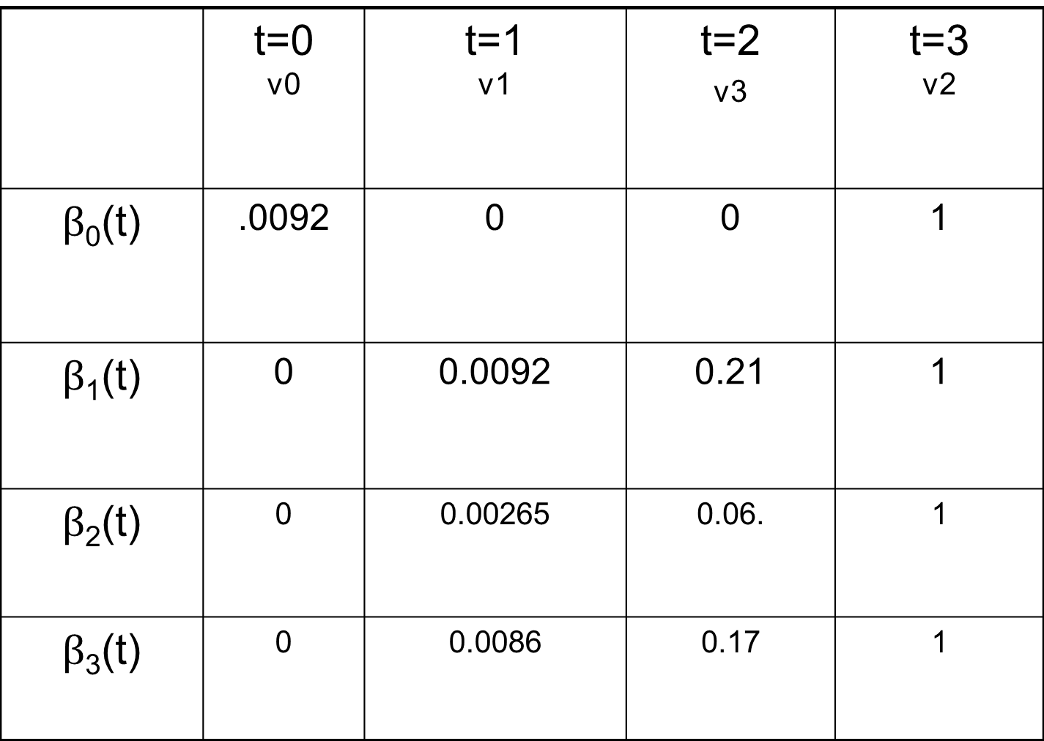
Backward Calculation
 | t=0 v0 | t=1 v1 | t=2 v3 | t=3 v2
$β$₀(t) | .0092 | 0 | 0 | 1
$β$₁(t) | 0 | 0.0092 | 0.21 | 1
$β$₂(t) | 0 | 0.00265 | 0.06. | 1
$β$₃(t) | 0 | 0.0086 | 0.17 | 1

Slide 16
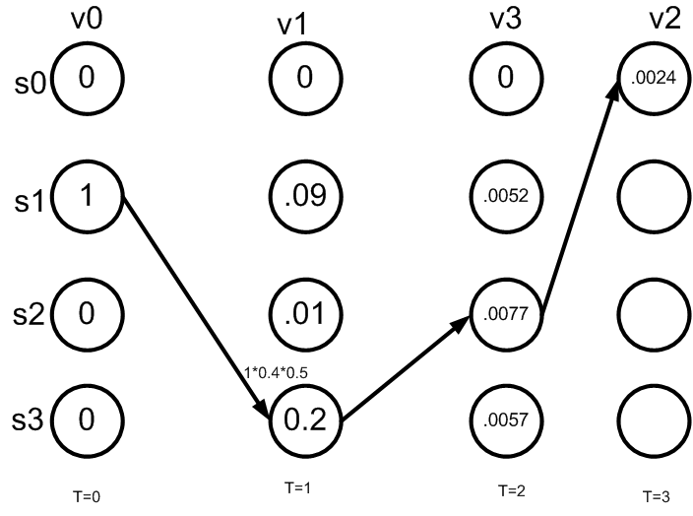
Decoding problem
Find the optimal path for the sequence v0 v1 v3 v2?
The problem is solved using Viterbi algorithm.

Slide 17
It is similar to dynamic programming approach.
Here we calculate the maximum probability among all the hidden states.
After that highest probability hidden state will be explored.
This process is continued upto final sequence.

Slide 18
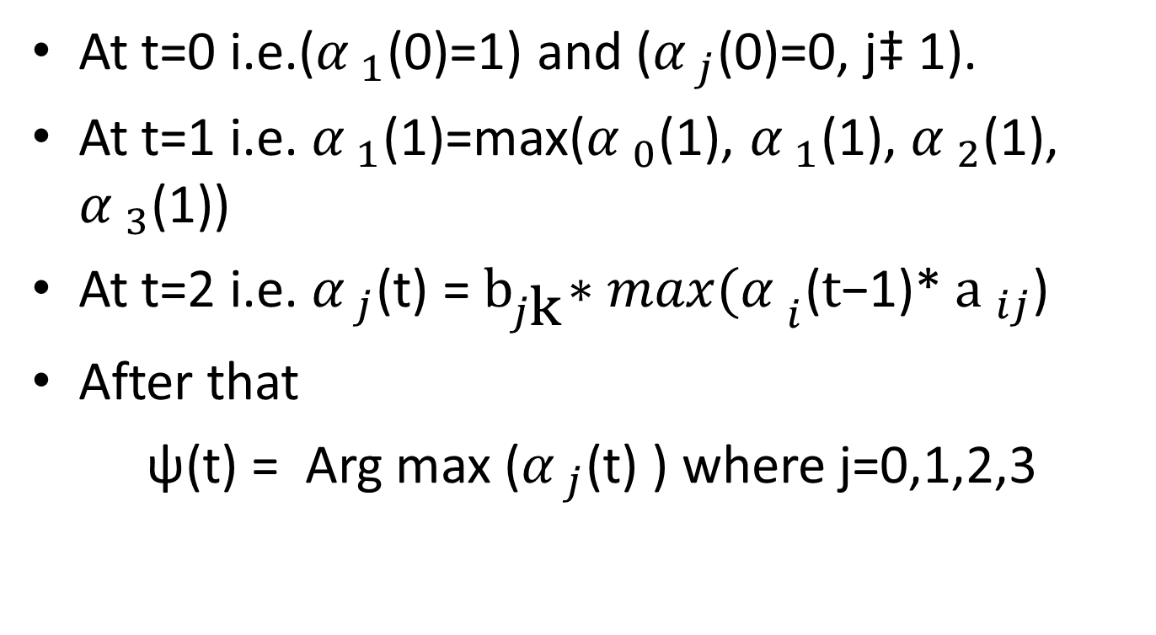
At t=0 i.e.(${α }_{1}$(0)=1) and (${α }_{j}$(0)=0, j‡ 1).
At t=1 i.e. ${α }_{1}$(1)=max(${α }_{0}$(1), ${α }_{1}$(1), ${α }_{2}$(1), ${α }_{3}$(1))
At t=2 i.e. ${α }_{j}$(t) = ${\text{b}}_{j\text{k}}∗max{(α }_{i}\text{(}t\text{−1)}$* ${\text{a} }_{ij}$)
After that
ψ(t) = Arg max (${α }_{j}$(t) ) where j=0,1,2,3

Slide 19
Viterbi Algorithm
 | t=0 v0 | t=1 v1 | t=2 v3 | t=3 v2
α₀(t) | 0 | 0 | 0 | 0
α₁(t) |  | 0.09 | 0.0208 | 0.00079
α₂(t) | 0 | 0.01 | 0.0011
α₃(t) | 0 |  |  | 0.000237
1
.001596
0.2
0.0228

Slide 20
Learning problem (1)
Learning problem. Given some training observation sequences O=o₁ o₂ ... o_{K} and general structure of HMM (numbers of hidden and visible states), determine HMM parameters M=(A, B, π) that best fit training data, that is maximizes P(O | M) .
There is no algorithm producing optimal parameter values.
Use iterative expectation-maximization algorithm to find local maximum of P(O | M) - Baum-Welch algorithm.

Slide 21
Learning problem (2)
If training data has information about sequence of hidden states (as in word recognition example), then use maximum likelihood estimation of parameters:
a_{ij}= P(s_{i} | s_{j}) =
Number of transitions from state s_{j} to state s_{i}
Number of transitions out of state s_{j}
Number of times observation v_{m} occurs in state s_{i}
Number of times in state s_{i}
b_{i}(v_{m} ) = P(v_{m} | s_{i})=

Slide 22
Baum-Welch algorithm
General idea:
Expected number of transitions from state s_{j} to state s_{i}
Expected number of transitions out of state s_{j}
a_{ij}= P(s_{i} | s_{j}) =
Expected number of times observation v_{m} occurs in state s_{i}
Expected number of times in state s_{i}
b_{i}(v_{m} ) = P(v_{m} | s_{i})=
π_{i} = P(s_{i}) = Expected frequency in state s_{i} at time k=1.

Slide 23
Baum-Welch algorithm: expectation step(1)
Define variable ξ_{k}(i,j) as the probability of being in state s_{i} at time k and in state s_{j} at time k+1, given the observation sequence o₁ o₂ ... o_{K} .
ξ_{k}(i,j)= P(q_{k}= s_{i} , q_{k+1}= s_{j} | o₁ o₂ ... o_{K})
P(q_{k}= s_{i} , q_{k+1}= s_{j} , o₁ o₂ ... o_{k})
P(o₁ o₂ ... o_{k})
ξ_{k}(i,j)=
=
P(q_{k}= s_{i} , o₁ o₂ ... o_{k}) a_{ij} b_{j} (o_{k+1} ) P(o_{k+2} ... o_{K} | q_{k+1}= s_{j} )
P(o₁ o₂ ... o_{k})
=
α_{k}(i) a_{ij} b_{j} (o_{k+1} ) β_{k+1}(j)
Σ_{i} Σ_{j} α_{k}(i) a_{ij} b_{j} (o_{k+1} ) β_{k+1}(j)

Slide 24
Learning problem (2)
If training data has information about sequence of hidden states (as in word recognition example), then use maximum likelihood estimation of parameters:
a_{ij}= P(s_{i} | s_{j}) =
Number of transitions from state s_{j} to state s_{i}
Number of transitions out of state s_{j}
Number of times observation v_{m} occurs in state s_{i}
Number of times in state s_{i}
b_{i}(v_{m} ) = P(v_{m} | s_{i})=

Slide 25
Baum-Welch algorithm
General idea:
Expected number of transitions from state s_{j} to state s_{i}
Expected number of transitions out of state s_{j}
a_{ij}= P(s_{i} | s_{j}) =
Expected number of times observation v_{m} occurs in state s_{i}
Expected number of times in state s_{i}
b_{i}(v_{m} ) = P(v_{m} | s_{i})=
π_{i} = P(s_{i}) = Expected frequency in state s_{i} at time k=1.

Slide 26
Baum-Welch algorithm: expectation step(1)
Define variable ξ_{k}(i,j) as the probability of being in state s_{i} at time k and in state s_{j} at time k+1, given the observation sequence o₁ o₂ ... o_{K} .
ξ_{k}(i,j)= P(q_{k}= s_{i} , q_{k+1}= s_{j} | o₁ o₂ ... o_{K})
P(q_{k}= s_{i} , q_{k+1}= s_{j} , o₁ o₂ ... o_{k})
P(o₁ o₂ ... o_{k})
ξ_{k}(i,j)=
=
P(q_{k}= s_{i} , o₁ o₂ ... o_{k}) a_{ij} b_{j} (o_{k+1} ) P(o_{k+2} ... o_{K} | q_{k+1}= s_{j} )
P(o₁ o₂ ... o_{k})
=
α_{k}(i) a_{ij} b_{j} (o_{k+1} ) β_{k+1}(j)
Σ_{i} Σ_{j} α_{k}(i) a_{ij} b_{j} (o_{k+1} ) β_{k+1}(j)

